Slide 1
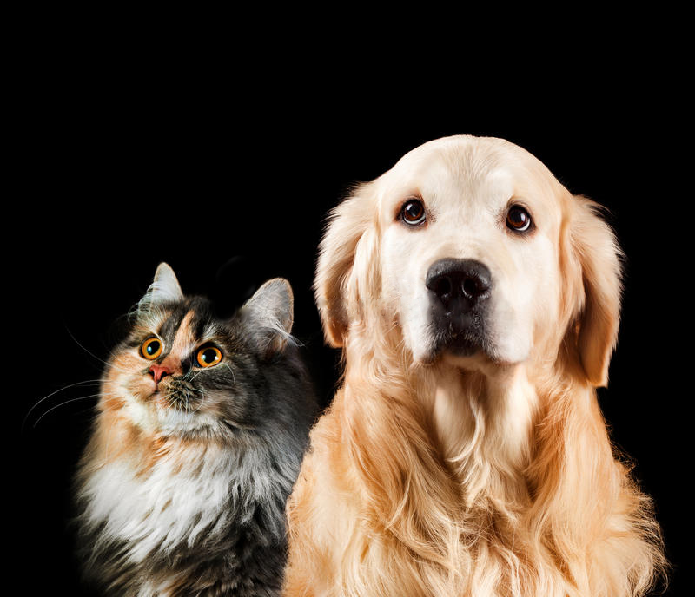

Graduation Project III
Pet Breeds
Classification
Gachon Univ.
AI·Software department
201635821 Ahn Giju
201635819 Shin DongJae

Slide 2
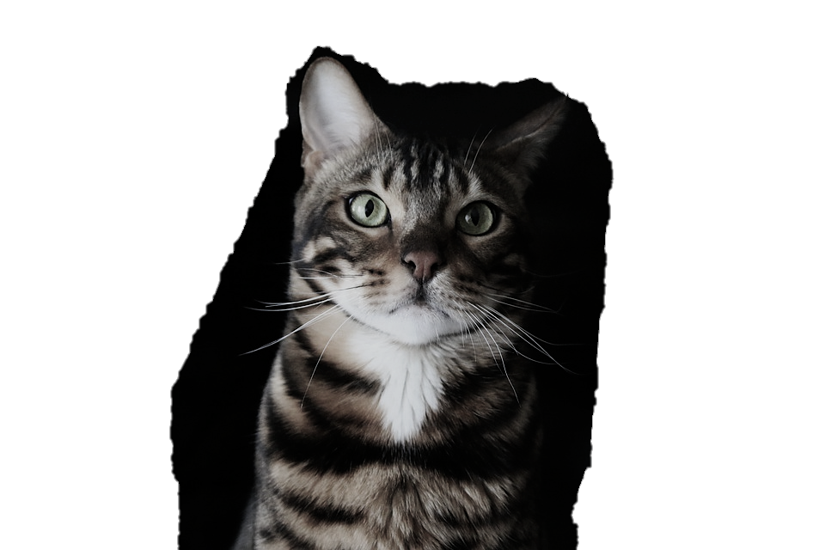
Contents
Introduction
Project Overview
Implementation
Experiments
Marketing Plan

Slide 3
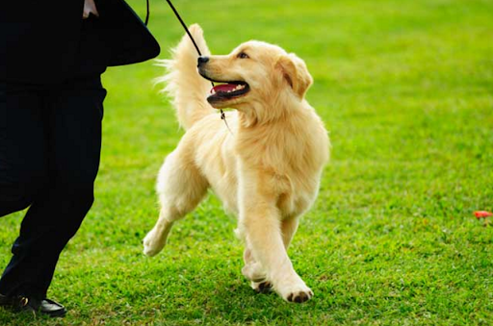
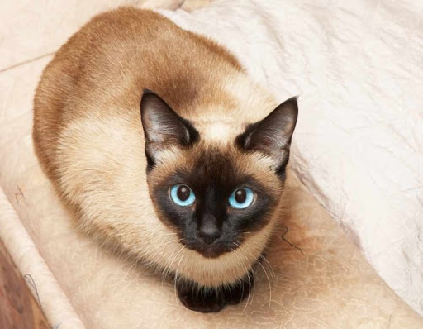
Introduction: motivation
Pet (dogs & cats) breeds classification
Presents dog/cat breeds that resemble human face
?
?

Slide 4
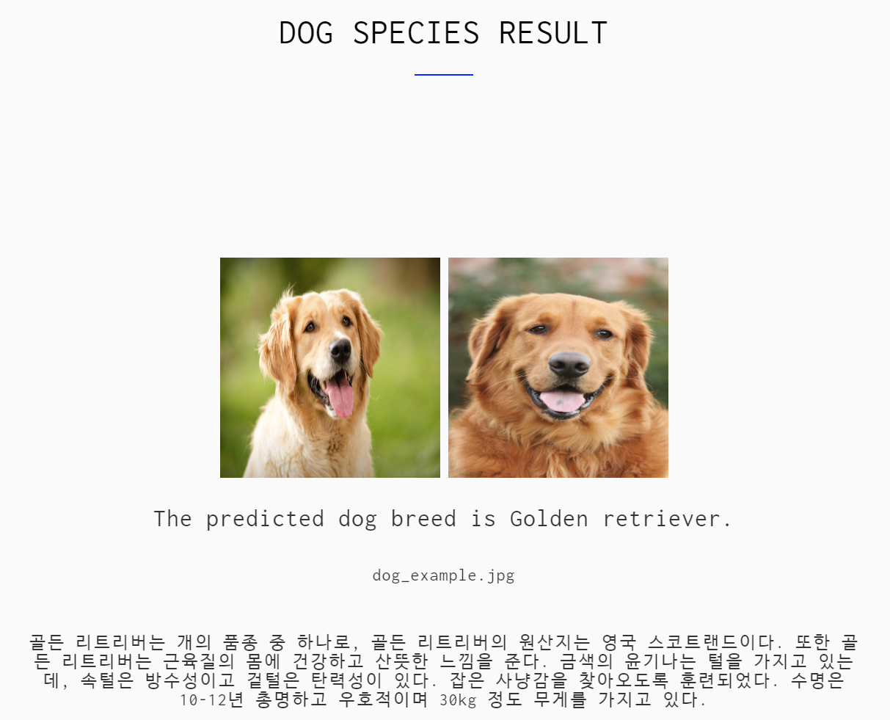
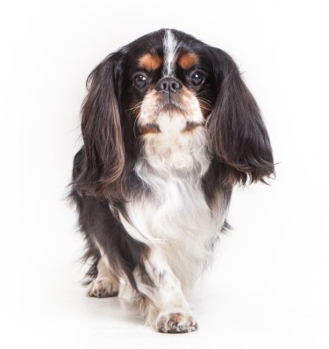
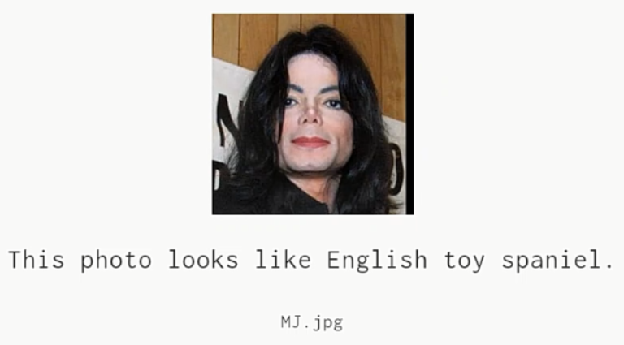
Introduction: features
We have created a python web-based application that tells us what breeds when pictures of cats & dogs are put in. Furthermore, when users put a picture of a human face, we added a function that tells them which breed of cat or dog they look like, added fun to it.

Slide 5
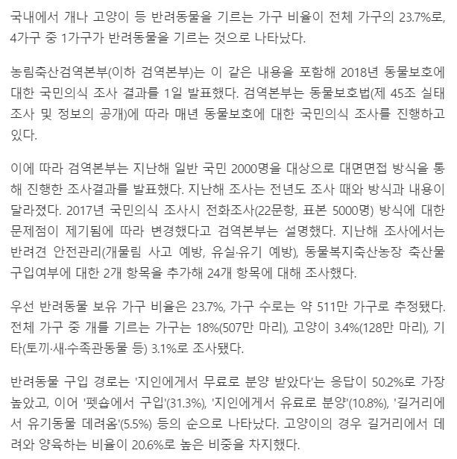
Introduction: features
133 species, 8351 Dog images
30 species, 4890 Cat images
Why?
If dogs and cats can be classified to a reasonable accuracy, over 90% of all pets can be covered.
dogs : cats ≈ 5 : 1
All images are automatically and manually preprocessed, ensure high quality of dataset.

Slide 6
Introduction: deployment
Our project is a web application,
and service at the address below.
📌 http://pet-classification.ddns.net:8080/

Slide 7
Project Overview: Quick look
The video has been deleted due to the upload capacity limit.

Slide 8
Project Overview: Responsive web design
The video has been deleted due to the upload capacity limit.

Slide 9
Project Overview: Pet breeds classification
The video has been deleted due to the upload capacity limit.

Slide 10
Project Overview: Human face
The video has been deleted due to the upload capacity limit.

Slide 11
Project Overview: Exception handling
The video has been deleted due to the upload capacity limit.

Slide 12

Implementation: API
Step 1)
Install Anaconda
Anaconda is a package manager that helps manage libraries used in data science, machine learning, and deep learning.

Slide 13
Implementation: API
Step 2)
Download ‘zolzak_conda_packages_export.txt’ here.
This text file is located in our project GitHub repository.
This text file is a list of libraries required for an anaconda virtual environment to run project.
Step 3)
Launch Anaconda prompt as administrator.

Slide 14
Implementation: API
Step 4)
User can run the command below to create a virtual environment and install packages at once!
$ conda create -n(--name) VENV_NAME --file PATH\zolzak_conda_packages_export.txt

Slide 15
Implementation: API
Step 5)
The following command let user download a project to user’s local storage.
$ git clone https://github.com/GijuAhn/Zolzak_PetBreedsClassification.git

Slide 16
Implementation: API
Step 6)
User can open, build, and run the project folder in Pycharm(or any other IDE).
Model architecture and learning processes have been modularized and made into APIs to allow users to easily modify and execute code themselves.

Slide 17
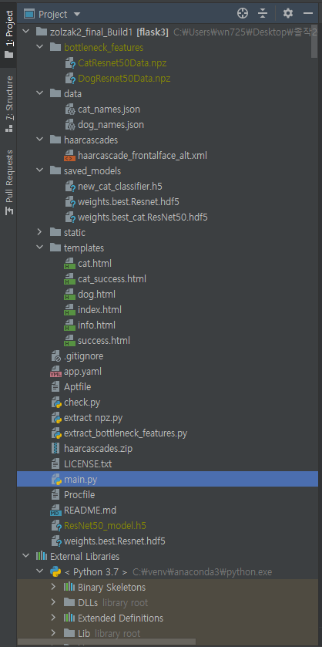
Implementation: Project structure
Core Components
main.py
bottleneck_features
data
haarcascades
saved_models
static
templates
cat.html
cat_success.html
dog.html
dog_success.html
info.html
index.html

Slide 18
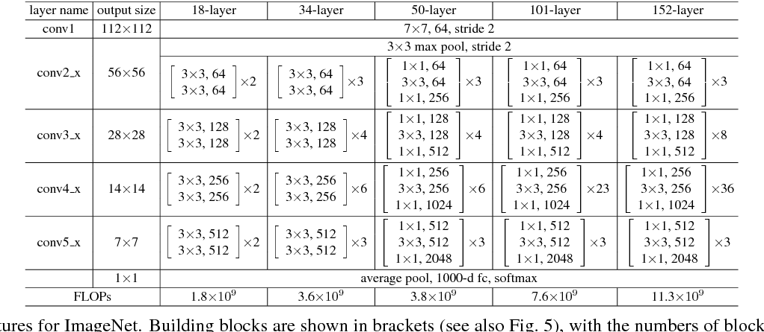
Implementation: technical info
ResNet50 transfer learning

Slide 19
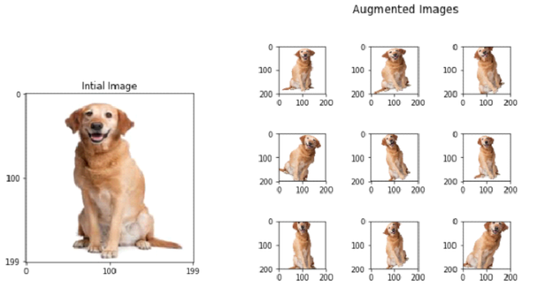
Implementation: technical info
Data Augmentation

Slide 20

Implementation: technical info
Why using 3*3 convolution filter?
5*5 filter × 1 ＜ 3*3 filter × 2
7*7 filter × 1 ＜ 3*3 filter × 3
3*3 filter makes less weight
Memory efficiency, fast learning
3*3 filter makes deeper layer
Get higher-dimensioned feature

Slide 21
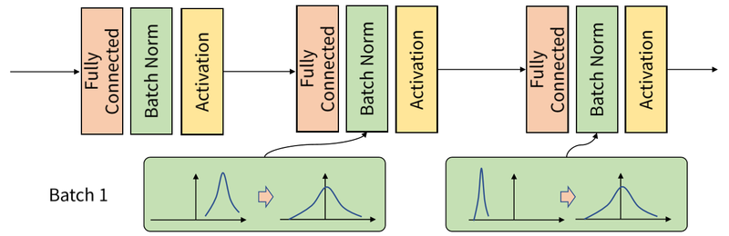
Implementation: technical info
Batch Normalization

Slide 22
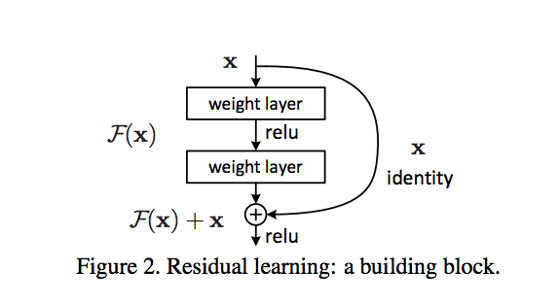
Implementation: technical info
Skip Connection

Slide 23
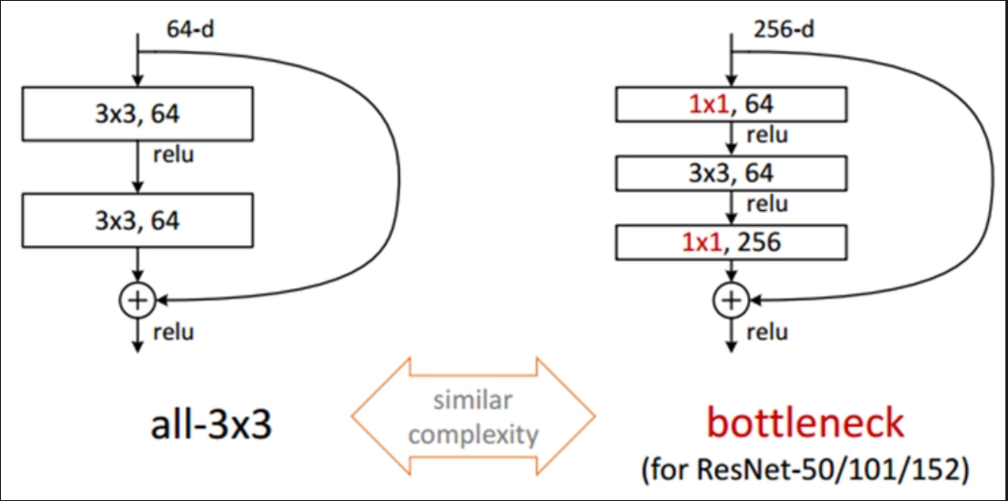
Implementation: technical info
Bottleneck feature
256 input filters are
compressed
by 64 1*1filter
↓
3*3 filtering
↓
64 input filters are
decompressed
by 256 1*1filter
Compared to all-3*3, the Bottleneck not only
allows x4 more inputs, but also has
less weight, making the calculation more efficient!

Slide 24
Experiments

Slide 25
Marketing Plan – 3C (Company)
SWOT
It is convenient to use because it has various access to mobile and web.
Dogs can be classified into 133 species. and Cats can be classified into 30 species
Find breeds that resemble human faces, fun to use.
S
Strength
w
Weakness
86% accuracy, insufficient to be commercialized.
Classification only for dogs/cats
Lack of computing power
Many people are curious about the breed of dogs and cats while passing by.
The pet market is growing, and cats and dogs account for a large portion.
O
Opportunity
T
Threat
The intrusion of large corporations.
Example : Google Lens
No initial revenue from service, but AWS server costs continue to arise as fixed cost.
Notes:
마케팅 전략으로는 우선 3C 컴퍼니, 경쟁자, 고객에 대해 분석해봤습니다.

Slide 26


Marketing Plan – 3C (Competitor)
Google Lens
Through the Google Lens application, you can find out plant or animal varieties, and even check out textual real-time translation or summary picture information about books.
TPU, a processor dedicated to machine learning developed by Google, is helping to learn large amounts of data, and the scope of application in real life is increasing.
Notes:
경쟁사는 구글렌즈를 선정하였는데 구글렌즈는 스마트폰의 카메라를 통해 동물 품종뿐만 아니라 식물이나 실시간 번역, 책에 대한 정보를 모바일 사용자에게 제공합니다. TPU라는 구글 자체 프로세서를 통해 매우 많은 양의 데이터를 짧은 시간내에 학습 시킬 수 있다고 합니다.

Slide 27


Marketing Plan – 3C (Customer)
Anyone who wants to know a breed about a dog/cat or who wants to find a breed that looks similar, easy to use & fun to use application.
As people's interest grows, they will see more pets nearby, and the demand for our applications will increase.

Slide 28
Marketing Plan – 4P
Product
Possible To deploy web applications through AWS EC2 servers to launch products.
Price
At first, it is going to increase the number of users through free service. Afterwards, if a certain number of users is secured, profits will be secured through advertising costs such as Google Ad-sense.
Place
It is available in any area with access to the Internet.
Promotion
SNS (YouTube and Facebook, Instagram)
GitHub Organization and open-source marketing
Notes:
4P 중 Product로는 aws서버를 통해 웹에 배포할수 있습니다.
Price로는 초기에는 무료로 이용자를 확보하고 어느정도의 이용자 수가 확보된다면 구글에드센스와 같은 광고를 통해 수익 모델을 만들 예정 입니다.
Place로는 어디서든지 인터넷만 연결되어있다면 모든 전자기기에서 사용 가능합니다
Promotion으로는 유튜브와 페이스북, 인스타그램에 홍보하고 개발자들의 관심을 사로잡을 수 있게 Github에 오픈소스 마케팅을 해볼 계획입니다.

Slide 29
Thank you.

